Slide 1
International Center for Appropriate and Sustainable Technology
Using Local Resources for Local Benefit

Slide 2
iCAST Mission
To provide economic, environmental, and social benefits to communities in a way that builds local capacity
Environmental Stewardship
Social Responsibility
Economic Development

Slide 3
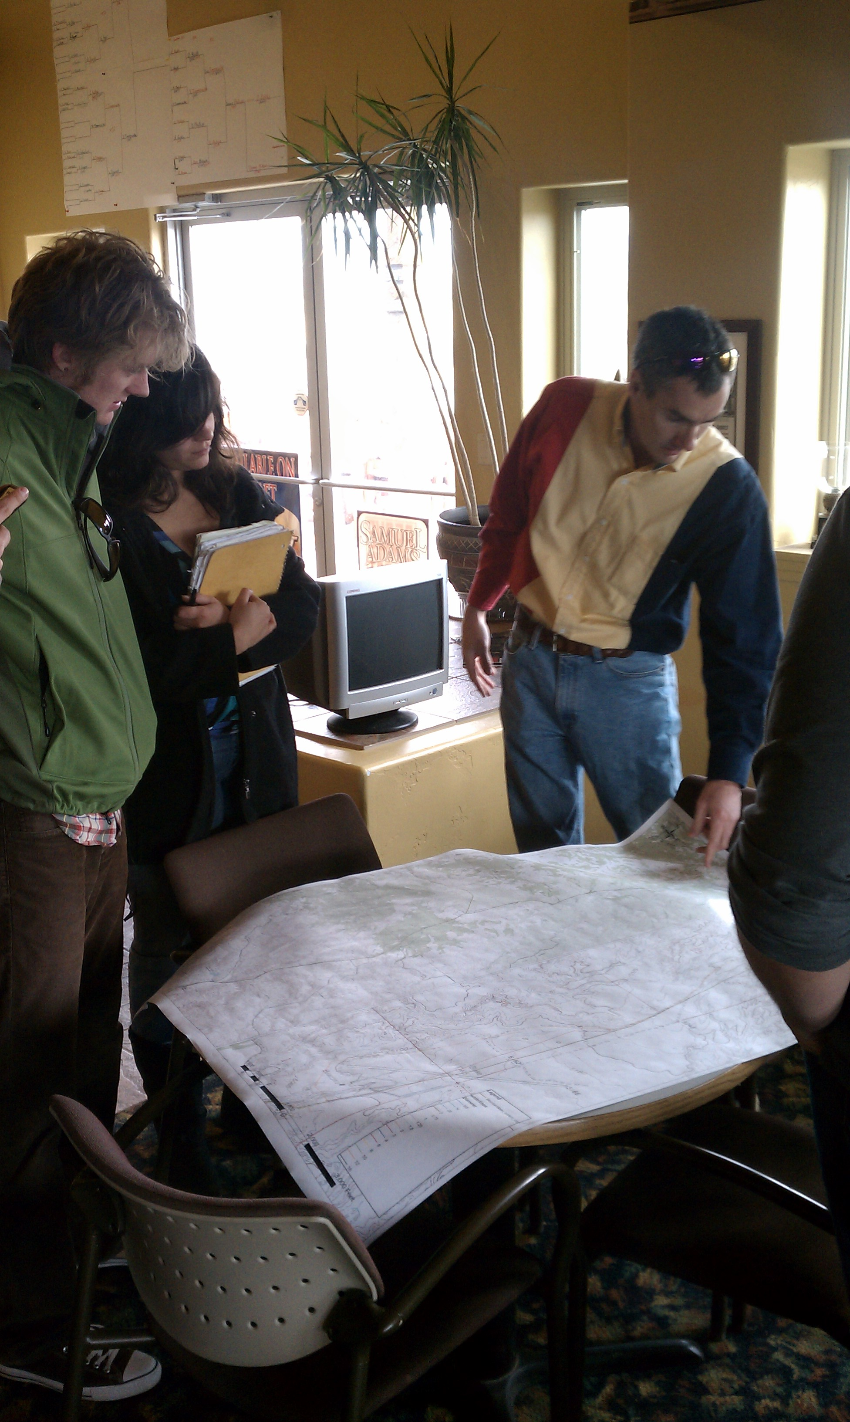
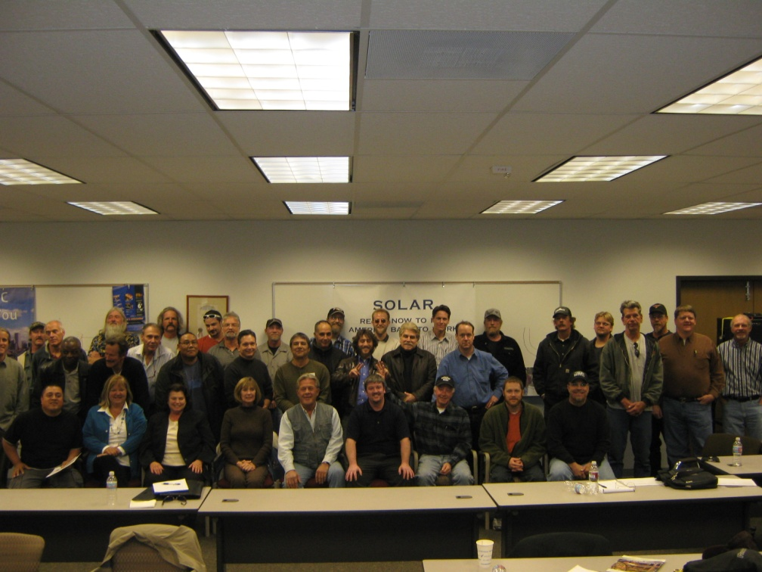
iCAST Services
Capacity Building
Service Learning
Workforce Development
Accelerator
EDO Training
Small Business Technical Assistance
Venture Creation
In-house
Partnerships

Slide 4
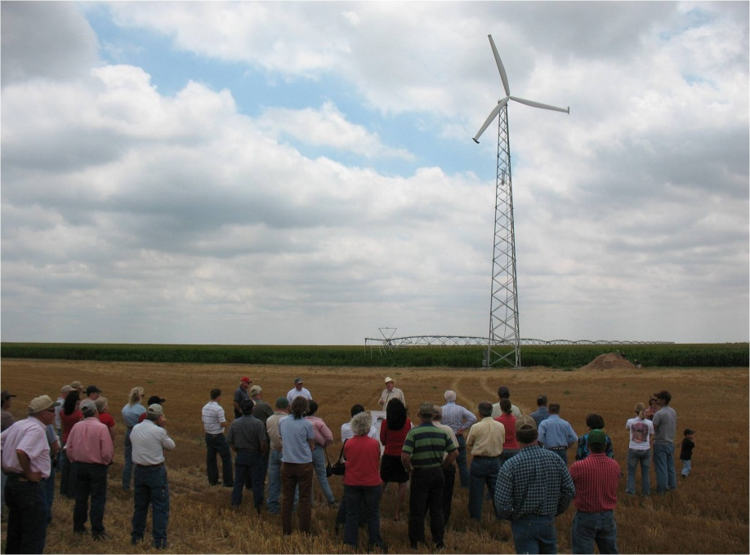
Accomplishments
Promoted the launch of eight for-profit start-ups and advised dozens of small businesses
Facilitated the creation of hundreds of jobs
Enabled economic impact worth over $200 Million;
Each Year:
Save over 7 Million kWh of energy
Reduced CO₂ emissions by 5 Million lbs
Engage 200+ interns and trainees
Serve 5,000+ people
Provided economic impetus worth over $10M

Slide 5
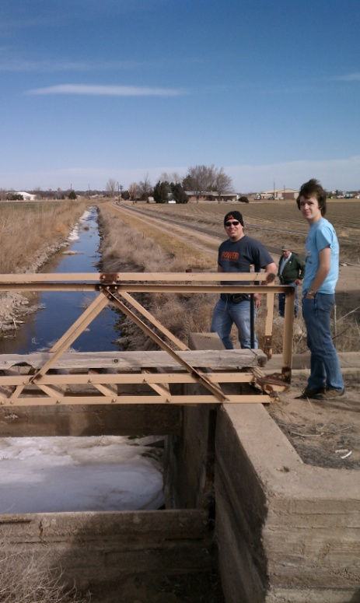
Service Learning
Focus on University Students
Internship Program
Independent or Academic Driven
Benefits to Interns
Real Life Experience
Teamwork Skills
Communication Skills
Try out a field before committing
Potential Employment
Networking
Fun & Hands On!

Slide 6
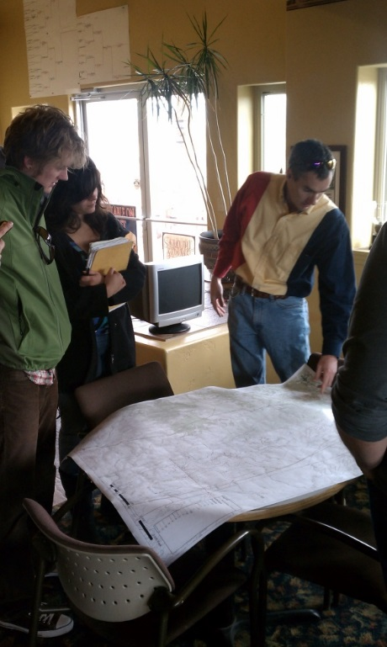
Small Business Technical Assistance
Social Enterprise focus
Triple Bottom-line benefits
Rural and Distressed Businesses
Micro and Small Business Focus
Business Consulting
Feasibility Analysis, Business Planning,
Marketing, Sales, Operations, Finance
Access to Financing and Talent
Community Self-Sufficiency and Well Being

Slide 7
Venture Creation

Slide 8
International Center for Appropriate and Sustainable Technology
Successful Entrepreneurship

Slide 9
“I believe that we are all born with the ability to be an entrepreneur, but we have to learn to unlearn the risk-adverse behavior that became part of our culture in the developed world over the past 500 years”
-Frank Moss
(researcher, technology and biotechnology entrepreneur, academician and author)

Slide 10
Entrepreneur?
An individual who establishes a new organization without the benefit of corporate sponsorship
A vision-driven individual who assumes significant personal and financial risk to start or expand a business
There is no ‘magic pill’ for becoming a successful Entrepreneur

Slide 11
Entrepreneurship?
A way of thinking, reasoning, and acting
Opportunity obsessed
Holistic in approach
And leadership balanced
Insane perseverance in the face of total rejection

Slide 12
Entrepreneurs’ Creed
“I do not wish to be a kept citizen. Humbled and dulled by having the State look after me. I want to take the calculated risk; to dream and to build. To fail and to succeed. I refuse to barter incentive for a dole;
I prefer the challenges of life to the guaranteed existence;
The thrill of fulfillment to the stale calm of Utopia. I will not trade freedom for beneficence, nor my dignity for a handout I will never cower before any master, nor bend to any threat. It is my heritage to stand erect. Proud and unafraid;
To think and act for myself, To enjoy the benefit of my creations And to face the world boldly and say: This … I have done All this is what it means to be an Entrepreneur.”
- Thomas Paine, Common Sense

Slide 13
Common Characteristics
According to the Center for Entrepreneurial Management:
Many are the children of self-employed parents
Many are descendants of immigrant parents or grandparents
Many were enterprising in their youth
Many are the oldest child
The majority state their prime reason for starting a business was to be on their own and not work for someone else

Slide 14
Kinds of Entrepreneurs
Craftspeople:
60% of all small business owners
Derive their sense of self-worth form their mastery of a craft or trade
Freedom Fighters:
30% of all small businesses
Prime motivation is simply being in business for themselves
Mountain Climbers:
10% of all small businesses
Growth-oriented business owners who are motivated almost solely by achievement

Slide 15
Myths about Entrepreneurship
Anyone can start a business
Entrepreneurs are gamblers
Entrepreneurs want the whole show to themselves
Entrepreneurs are their own bosses and completely independent
Entrepreneurs work longer and harder than managers in big companies
Entrepreneurs experience a great deal of stress and pay a high price
Entrepreneurs are motivated solely by the quest for the almighty dollar

Slide 16
Myths about Entrepreneurship
Entrepreneurs seek power and control over others
If an entrepreneur is talented, success will happen in a year or two
Any idea with a good idea can raise venture capital
If an entrepreneur has enough start-up capital, he/she can’t miss
Entrepreneurs are lone wolves and cannot work with others
Unless you attained 1600 on your SATs or GMATs, you’ll never be a successful entrepreneur

Slide 17
Entrepreneurism in the US Economy

Slide 18
Who is the Entrepreneur?
SOURCE: J. Timmons and S. Spinelli, New Venture Creation, 6th ed.
(New York: McGraw-Hill/Irwin, 2004), p.65.

Slide 19
Strategy of the Entrepreneur
SOURCE: From “Entrepreneurial Strategy Matrix: A Model of New and Ongoing Ventures” by Sonfield and Lussier. Reprinted from Business Horizons, May-June1997Copyright 1997 by the Trustees at Indiana University, Kelley School of Business

Slide 20
Timmons Model of Entrepreneurial Process

Slide 22
Entrepreneurs’ Advice
Do what gives you energy - have fun
Figure out how to make it work
Anything is possible if you believe you can do it
If you don’t know it can’t be done, then go ahead and do it
Don’t accept the way things are - look for ways to improve them
Do things differently
Businesses fail. Successful entrepreneurs learn from failure
It’s easier to beg for forgiveness than ask for permission

Slide 23
Entrepreneurs’ Advice
Make opportunity and results your obsession - not money
Making money is even more fun than spending it
Take pride in your accomplishments - it’s contagious
Sweat the details that are critical to success
Make the pie bigger - don’t waste time trying to cut smaller pieces
Play for the long haul. It’s rarely possible to get rich quickly
Remember: only the lead dog gets a change in scenery

Slide 24
Key Traits
Responsibility
All entrepreneurs have to take responsibility for the success of their own organization
Passion
Pursue something you already have an awareness of and support whole heartedly
Motivated
Positive attitude; set high goals; perform to high standards; take calculated risks

Slide 25
Key Traits
Kaizen
"improvement", or "change for the better“ philosophy or practices that focus upon continuous improvement of processes in manufacturing, engineering, and business management
Optimistic
Critical to be optimistic in problem solving.
Persistent
Creative
Responsive
Flexible and understand the market changes.

Slide 26
Key Traits
Inquisitive
Always listening and learning, curiosity is insatiable; typically into everything - want to know how and why it works; curiosity often contributes to new innovation and creativity
Self-confident
Competitive drive; naturally want to be the best at what they do; able to channel their competitive drive in a positive fashion; focus on raising their own bar
Risk-taker
If there is no risk, generally, there is no reward

Slide 27
Key Skills
Action-oriented
Persist and finish projects; take action and address opportunities with little support
Driven
Develop a plan; identify what goals they want to achieve; document the tasks required; track and measure results
Active-listening
Attends to non-verbal cues to better understand others perspectives, behaviors, or motivations.

Slide 28
Key Skills
Customer Focus
Understand customer’s short and long-term needs, see issues from the customer’s position, and recommend the appropriate products and services
Relationship Management
Build rapport and trust employees; maintain networks of contacts and professional relationships with associates, customers, and suppliers

Slide 29
Key Skills
Flexibility
Able to wear many hats; ability and desire to perform many different tasks
Communication
Good ideas require asking people for input and listening carefully

Slide 30
Entrepreneurial Ingredients
A great idea
Spot, create and exploit opportunities
Technological discoveries
Demographic changes/shifts
Lifestyle/Taste chances
Economic dislocation
Government initiatives / rule changes

Slide 31
What’s Your Opportunity?
Step 1: Identify Your Business and Personal Goals
Step 2: Research Your Favorite Industries
Step 3: Identify Promising Industry Segments
Step 4: Identify Problem Areas and Brainstorm Solutions
Step 5: Compare Possible Solutions with Your Objectives and Opportunities in the Marketplace
Step 6: Focus on the Most Promising Opportunities

Slide 32
Types of Ventures
Lifestyle:
Independence, autonomy and control; typically run out of household; flexibility; personal interests aligned with desire for profit
Smaller Profit:
Smaller company and desire to maintain size, not driven by desire for inordinately large profits, “Mom & Pop Shops”
High Growth:
Focus on maximum profits & growth, “pushing the envelope”, driven by innovation

Slide 33
How to Finance Your Opportunity?
Personal Funds
“Love Money” – aka Friends and Family
Banks and Similar Traditional Institutions
Operating Loans
Term Loans
Federal Government
Small Business Administration
Grants

Slide 34
How to Finance Your Opportunity?
State/Local Economic Development Programs
Venture Capital and “Angel” Investors
Other Sources of Financing
Personal Credit Cards
Suppliers’ Inventory Buying Plans
Leasing vs. Buying
Negotiated Leasehold Improvements
Advance Payment from Customers – aka KickStarter

Slide 35
Thank You
QUESTIONS?
Ravi Malhotra, President
RaviM@iCASTusa.org
720-261-1086

Slide 36
SBA Disclaimer
This U.S. Small Business Administration (SBA) Cooperative Agreement is partially funded by the SBA. SBA's funding is not and endorsement of any products, opinions or services. All SBA funded programs are extended to the public on a non-discriminatory basis.

